Slide 1

Jingwei Wu, PhD
Chapter 6
Introduction to Hypothesis Testing
A courtesy of “USING AND INTERPRETING STATISTICS” by ERIC W. CORTY | THIRD EDITION (Macmillan Education)

Slide 2

Objectives
The Logic of Hypothesis Testing
Hypothesis Testing in Action
Type I Error, Type II Error, Beta, and Power

Slide 3
Logic of Hypothesis Testing
Hypothesis
Proposed explanation for observed facts
Statement or prediction about a population value
Hypothesis testing
Statistical procedure in which data from a sample are used to evaluate a hypothesis about a population
Examples
Cognitive psychologist hypothesizes IQ in a population is 100
Amie believes (hypothesizes) that Allen loves her

Slide 4
Ten Facts About Hypotheses and Hypothesis Testing
A hypothesis is a statement about a population, not a sample.
In hypothesis testing, there are two hypotheses, the null hypothesis (H₀) and the alternative hypothesis (H₁).
The two hypotheses must be all-inclusive.
The two hypotheses must be mutually exclusive.
The null hypothesis is a negative statement and makes a specific prediction.
The alternative hypothesis, which is what the researcher believes is true, isn’t a specific prediction.

Slide 5
Ten Facts About Hypotheses and Hypothesis Testing (continued)
One can’t prove a negative statement.
But one can disprove a negative statement. And all it takes is one example.
If the null hypothesis is disproved (rejected), then the researcher has to accept the mutually exclusive alternative hypothesis.
If the researcher fails to disprove the null hypothesis, he or she can’t say that the null hypothesis is true. The best that can be said is that one hasn’t found enough evidence to reject it.

Slide 6
Null versus Alternative Hypothesis
Null hypothesis (Fact 5)
Abbreviated H₀
Statement that in the population the independent variable has no impact on the dependent variable
Alternative hypothesis (Fact 6)
Abbreviated H₁
Statement that the independent variable has an effect on the dependent variable in the population; usually, a statement of what the researcher believes to be true

Slide 7

Ten Facts About Hypotheses and Hypothesis Testing
Fact 7
Fact 8
It is impossible to prove a negative hypothesis, but one positive example will disprove it.

Slide 8
Hypothesis Testing in Action
Six Steps of Hypothesis Testing
STEP 1 Test: Pick the right statistical test.
STEP 2 Assumptions: Check the assumptions to make sure it is OK to do the test.
STEP 3 Hypotheses: List the null and alternative hypotheses.
STEP 4 Decision rule: Find the critical value that determines when to reject the null hypothesis.
STEP 5 Calculation: Calculate the value of the test statistic.
STEP 6 Interpretation: Say in plain language what the results mean.

Slide 9

Step 1: Pick a Test
Which test to use?
Hundreds of tests, each designed for a specific purpose
Choosing the correct hypothesis test depends on several factors:
Question being asked
Type of study being done
Level of measurement of the data
Picking the right test requires thought.

Slide 10
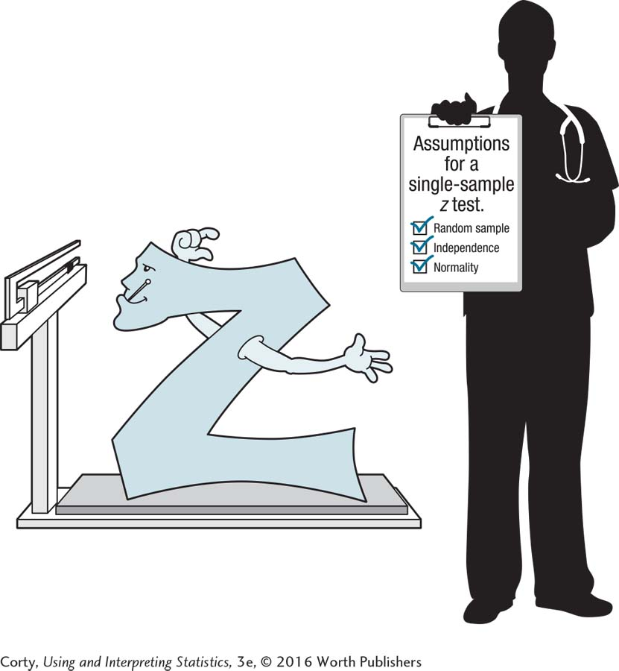
Step 2: Check the Assumptions
All statistical tests have assumptions
Nonrobust assumption
Assumption for a statistical test that must be met in order to proceed with the test
Robust assumption
Assumption for a statistical test that can be violated to some degree; it is still OK to proceed with the test
Before one can proceed with a test, one needs to make sure that its assumptions have been met.

Slide 11
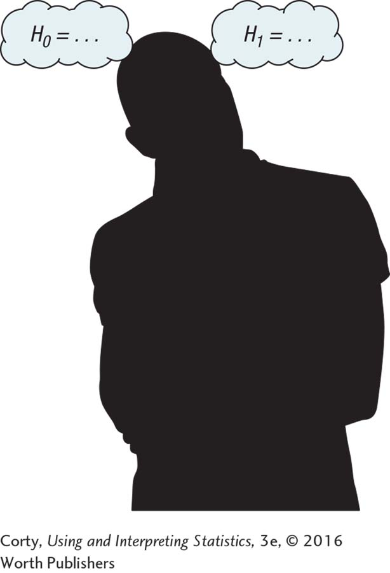
Step 3: List the Hypotheses
List the null hypothesis and alternative hypothesis
Hypotheses can be two-tailed or one-tailed.
Two-tailed hypothesis test
Hypothesis that predicts the independent variable has an impact on the dependent variable, but does not predict the direction of the impact.
It is also called a nondirectional test.
One-tailed hypothesis test
Hypothesis that predicts the independent variable has an impact on the dependent variable in a specific direction.
It is easier to reject the null hypothesis.
The null and alternative
hypotheses need to be specified for every statistical test.

Slide 12
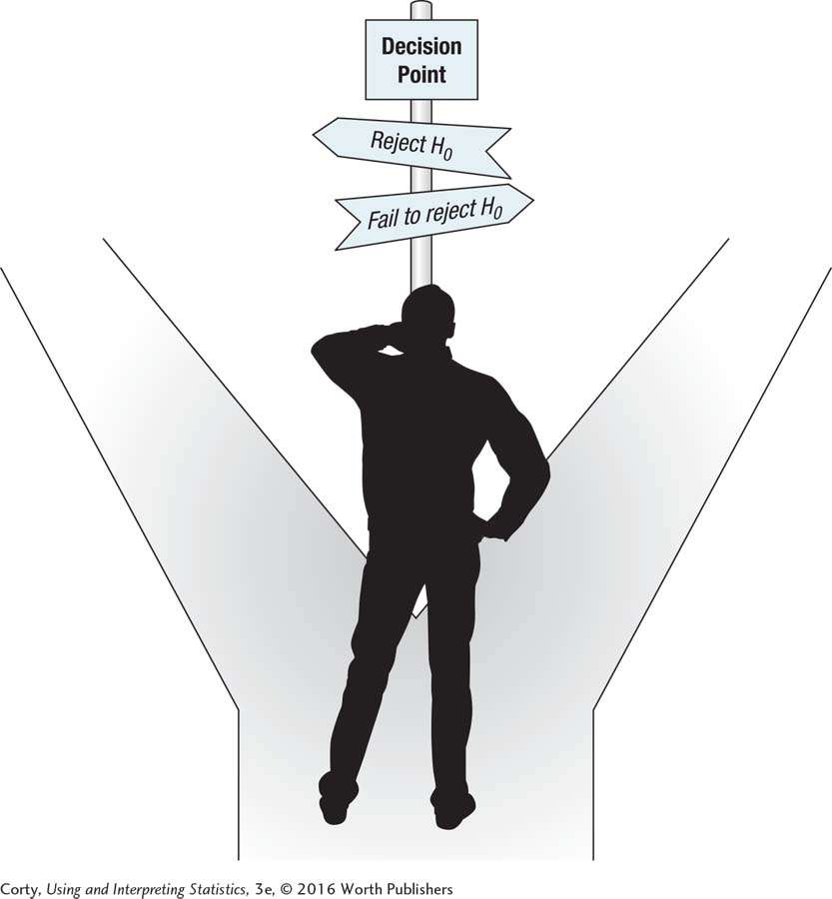
Step 4: Set the Decision Rule
Find the critical value of the test statistic.
Critical value is the value of the test statistic that forms the boundary between the rare zone and the common zone of sampling distribution of the test statistic.
Decision rule is made in advance.
Setting the decision rule in advance means that one knows what to do when a choice point is reached.

Slide 13

Step 5: Calculate the Test Statistic
Calculate the test statistic:
Plug the right numbers into a formula.
Calculating the value for a test statistic is the fifth step in hypothesis testing.

Slide 14
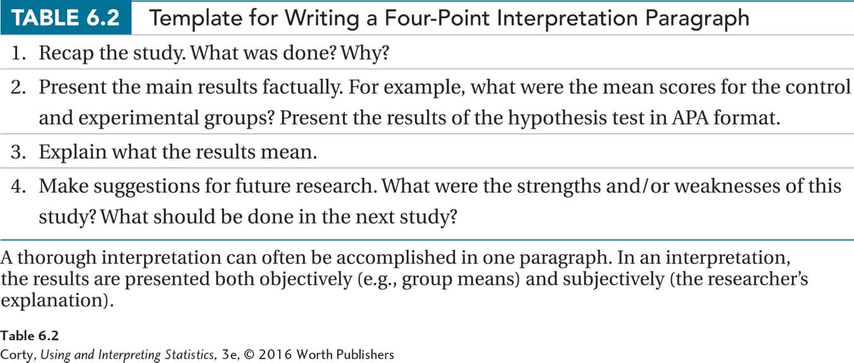
Step 6: Interpret the Results
Four parts to writing an interpretation
Recap why the study was done.
Provide the main factual results, for example, the mean scores for the control group and the experimental group.
Explain what the results mean.
Make suggestions for future research.

Slide 15
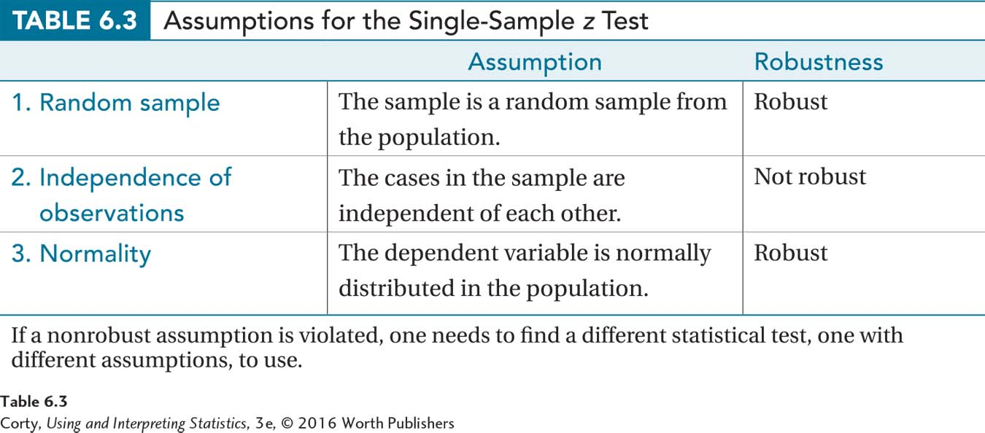
Six Steps of Hypothesis Testing: Example
Do adopted children differ in intelligence from the general population?
STEP 1: Pick a Test
Single-sample z test (IQ population standard deviation known, σ = 15)
STEP 2: Check the Assumptions
Random sample
Independence of observations
Normality

Slide 16
Six Steps of Hypothesis Testing: Example (continued)
STEP 3: List the Hypotheses: Two-tailed test, generate null hypothesis first, alternative hypothesis second
Null Hypothesis (H₀) H₀:μ_{AdoptedChildren} = 100
Statement about the population; μ is the population mean
Negative statement: intelligence of adopted children is not different from the mean IQ for the population of children
Specific statement: population mean is exactly 100
Alternative Hypothesis (H₁) H₁:μ_{AdoptedChildren} ≠ 100
States that the population mean for adopted children is something other than 100

Slide 17
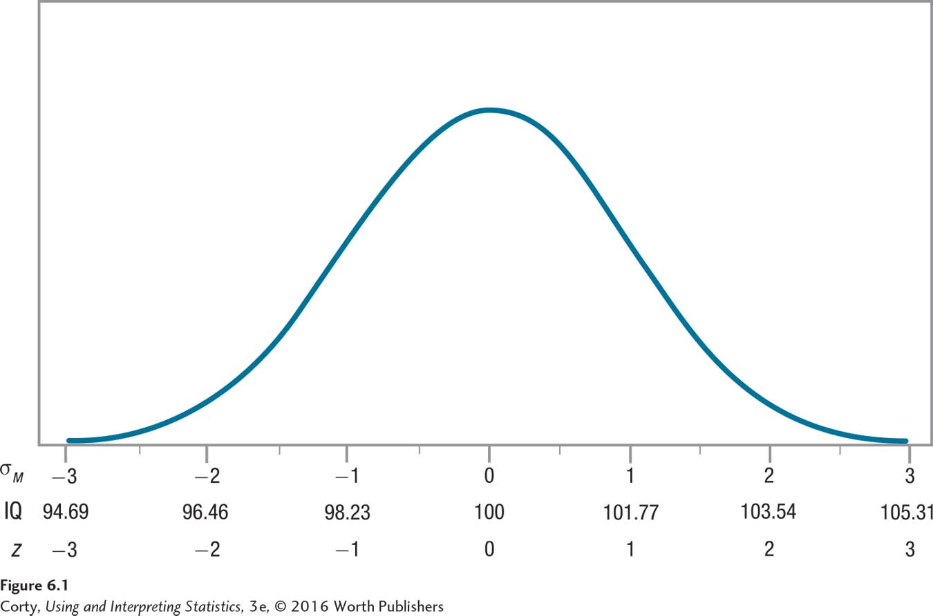
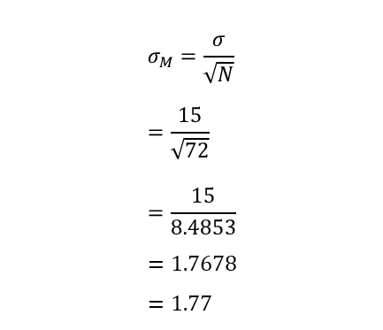
Six Steps of Hypothesis Testing: Example (continued)
STEP 4: Set Decision Rule
Distribution shows what the sampling distribution of the mean would look like for repeated random samples of N = 72 from a population with mean IQ of 100.
Standard error of the mean, σ_{M} = 1.77
$$σ_{M}=\frac{σ}{\sqrt{N}} \\ =\frac{15}{\sqrt{72}} \\ =\frac{15}{8.4853} \\ =1.7678 \\ =1.77$$
Sampling Distribution of the Mean This distribution shows what the sampling distribution of the mean would look like for repeated random samples of size 72 from a population with a mean IQ of 100. Note that it is normally distributed and centered around the population mean.

Slide 18
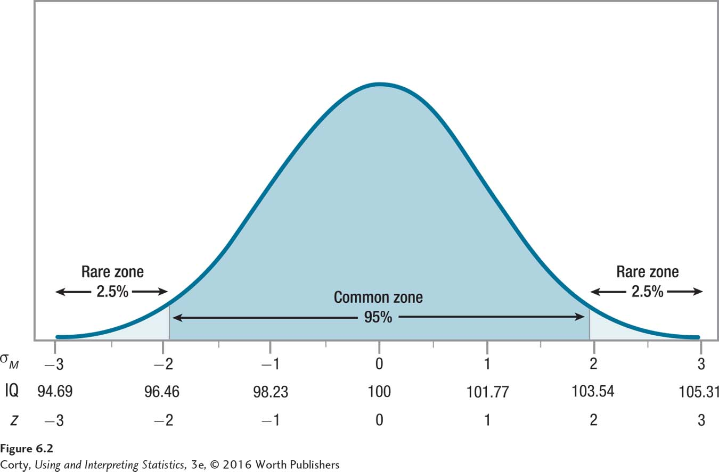
Six Steps of Hypothesis Testing: Example (continued)
STEP 4: Set Decision Rule

Slide 19
Six Steps of Hypothesis Testing: Example (continued)
STEP 4: Set Decision Rule
Common zone
Section of the sampling distribution of a test statistic in which the observed outcome should fall if the null hypothesis is true; typically, 95% of the sampling distribution
Rare zone
Section of the sampling distribution of a test statistic in which it is unlikely an observed outcome will fall if the null hypothesis is true; typically, 5% of the sampling distribution
Standard error of the mean, σ_{M} = 1.77

Slide 20
Six Steps of Hypothesis Testing: Example (continued)
STEP 4: Set Decision Rule
Size of the rare zone expressed as a probability is the alpha level of the test
Alpha or alpha level
Probability of making a Type I error; the probability that a result will fall in the rare zone and the null hypothesis will be rejected when the null hypothesis is true; often called significance level
Abbreviated α; usually set at .05 or 5%; α = .05
Significance level
Probability of Type I error; the same as alpha level

Slide 21
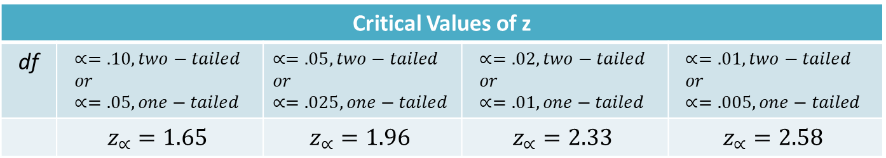
Six Steps of Hypothesis Testing: Example (continued)
STEP 4: Set Decision Rule
Critical Values of z, One-Tailed and Two-Tailed, for Commonly Used Alpha Levels for Single-Sample z Tests
Critical Values of z
df | $$∝=.10, two−tailed \\ or \\ ∝=.05, one−tailed$$ | $$∝=.05, two−tailed \\ or \\ ∝=.025, one−tailed$$ | $$∝=.02, two−tailed \\ or \\ ∝=.01, one−tailed$$ | $$∝=.01, two−tailed \\ or \\ ∝=.005, one−tailed$$
 | $$z_{∝}=1.65$$ | $$z_{∝}=1.96$$ | $$z_{∝}=2.33$$ | $$z_{∝}=2.58$$

Slide 22
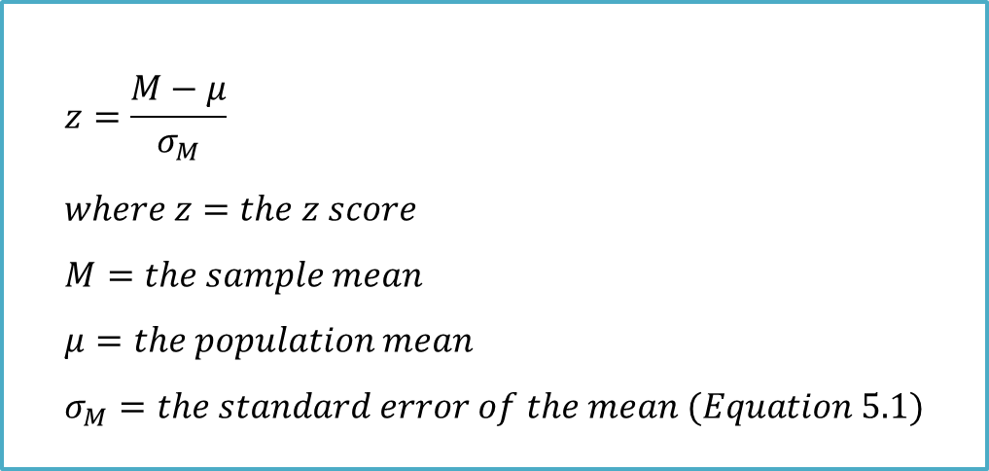
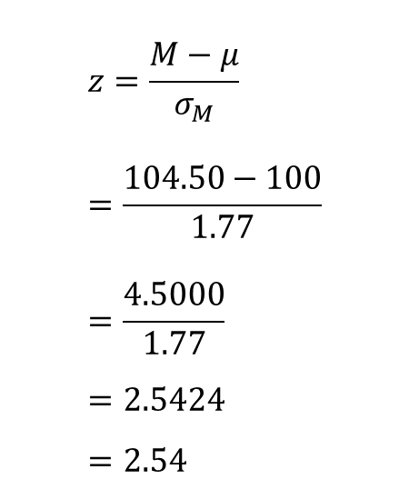
Six Steps of Hypothesis Testing: Example (continued)
STEP 5: Calculate the Test Statistic
$$z=\frac{M−μ}{σ_{M}} \\ =\frac{104.50−100}{1.77} \\ =\frac{4.5000}{1.77} \\ =2.5424 \\ =2.54$$
$$z=\frac{M−μ}{σ_{M}} \\ where z=the z score \\ M=the sample mean \\ μ=the population mean \\ σ_{M}=the standard error of the mean (Equation 5.1)$$

Slide 23
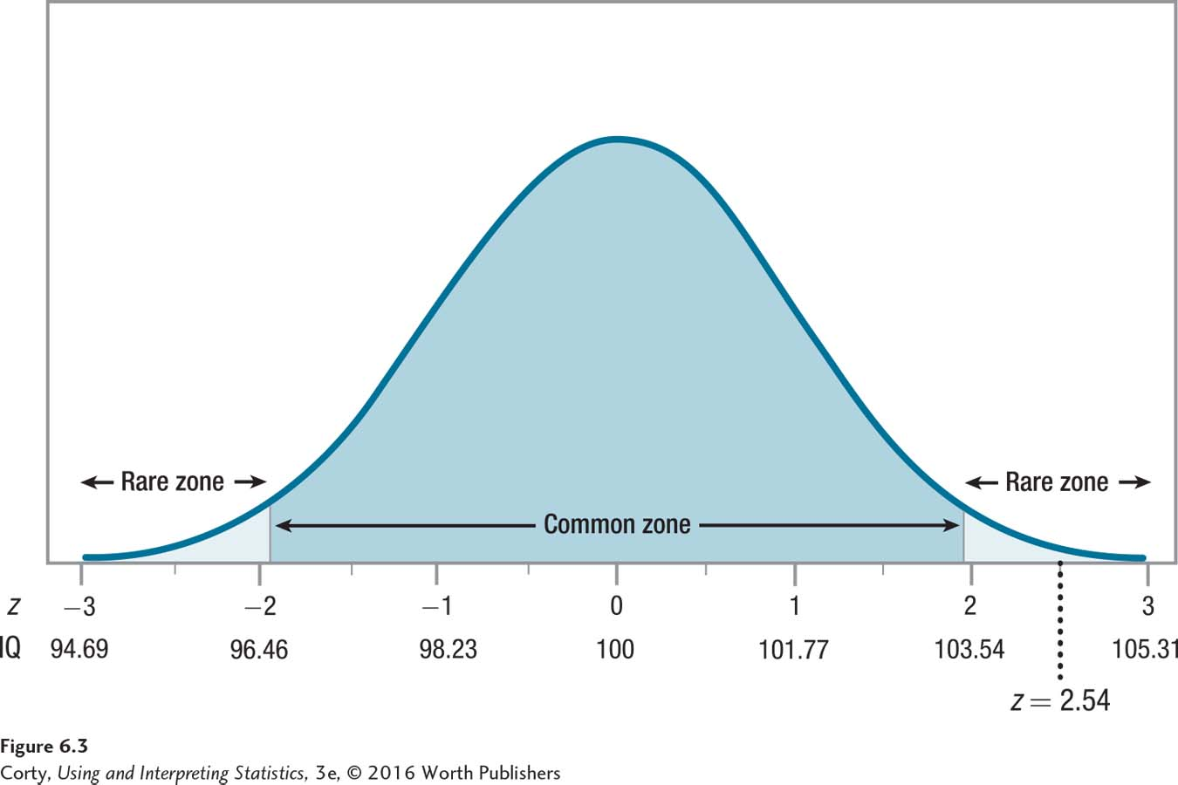
Six Steps of Hypothesis Testing: Example (continued)
STEP 6: Interpret the Results
Observed mean of 104.5 has been converted to a z score of 2.54.
It falls in the rare zone.
Null hypothesis is rejected.
Sampling Distribution of the Mean, Marked with Observed z Score, for IQ Data

Slide 24
Six Steps of Hypothesis Testing: Example (continued)
STEP 6: Interpret the Results
Statistically Significant
When a researcher concludes that the observed sample results are different from the null-hypothesized population value
Example: Adoption IQ. Dr. Pell could state that the observed mean of 104.5 is “statistically significant”

Slide 25
Six Steps of Hypothesis Testing: Example (continued)
STEP 6: Interpret the Results
APA format: z(N = 72) = 2.54, p < .05
z tells what test was done, a z test
N = 72 gives the sample size
2.54 is the value of the test statistic that was calculated
.05 refers to the alpha level (APA format uses the letter p, so it is often referred to as the p value)
p < .05 informs the reader that the null hypothesis was rejected
p value
Probability of Type I error

Slide 26
Four Possible Outcomes for Hypothesis Tests
 | H₀ is really true | H₀ is really not true
We fail to reject H₀ | A Results fall in common zone. Correctly say, “Fail to reject H₀” | B Results fall in common zone. Erroneously say, “Fail to reject H₀”
We reject H₀ | C Results fall in rare zone. Erroneously say, “Reject H₀” | D Results fall in rare zone. Correctly say, “Reject H₀”
Cells A and D are correct decisions; B and C are erroneous decisions.

Slide 27
Four Possible Outcomes for Hypothesis Tests
Example: Dr. Cipriani asks, Does new treatment for depression work?
Outcome A and Outcome D are good outcomes for a hypothesis test
Outcome A: Dr. Cipriani fails to reject the null hypothesis. The treatment does not work and she finds no evidence that it does.
Outcome D: she rejects the null hypothesis. The treatment does work and she finds evidence that it does.
Outcome B and Outcome C are bad outcomes for a hypothesis test
Outcome B: Dr. Cipriani fails to reject the null hypothesis. But it is the wrong conclusion as the treatment really does work.
Outcome C: she rejects the null hypothesis. But it is a wrong conclusion, because the treatment doesn’t work.

Slide 28
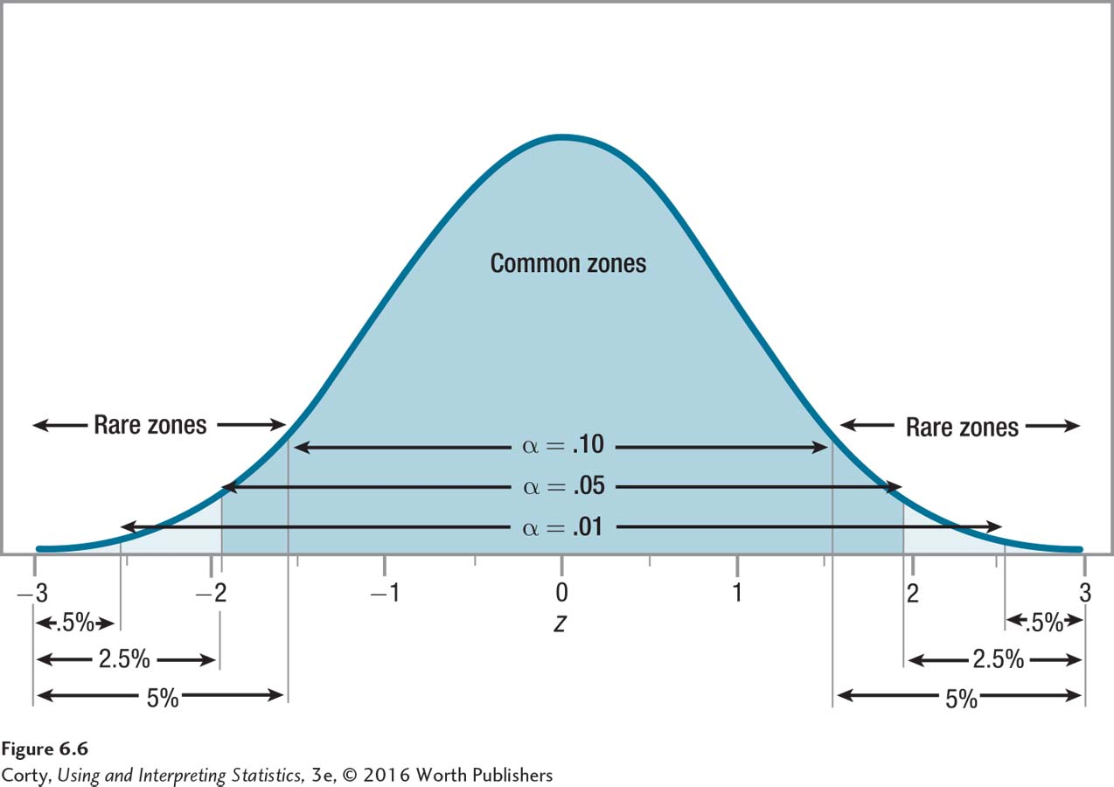
Type I Error
Type I Error
Error that occurs when the null hypothesis is true but is rejected
Alpha
p(Type I error) = α
Usually set at .05
Example of Type I Error
Does new treatment for depression work?
Outcome C: Dr. Cipriani concludes that the treatment makes a difference when it really doesn’t.
See Figure 6.6
The Size of the Rare Zone and the Common Zone for Different Alpha Levels

Slide 29
Type II Error and Beta
Type II Error
Error that occurs when the null hypothesis should be rejected, but it isn’t
p(Type II error) = β
Beta
Probability of making a Type II error; abbreviated β
Commonly set at .20: a 20% chance for this error
Example of Type II Error
Does new treatment for depression work?
Outcome B: Dr. Cipriani’s new treatment for depression was effective, but she didn’t find evidence that it was effective

Slide 30
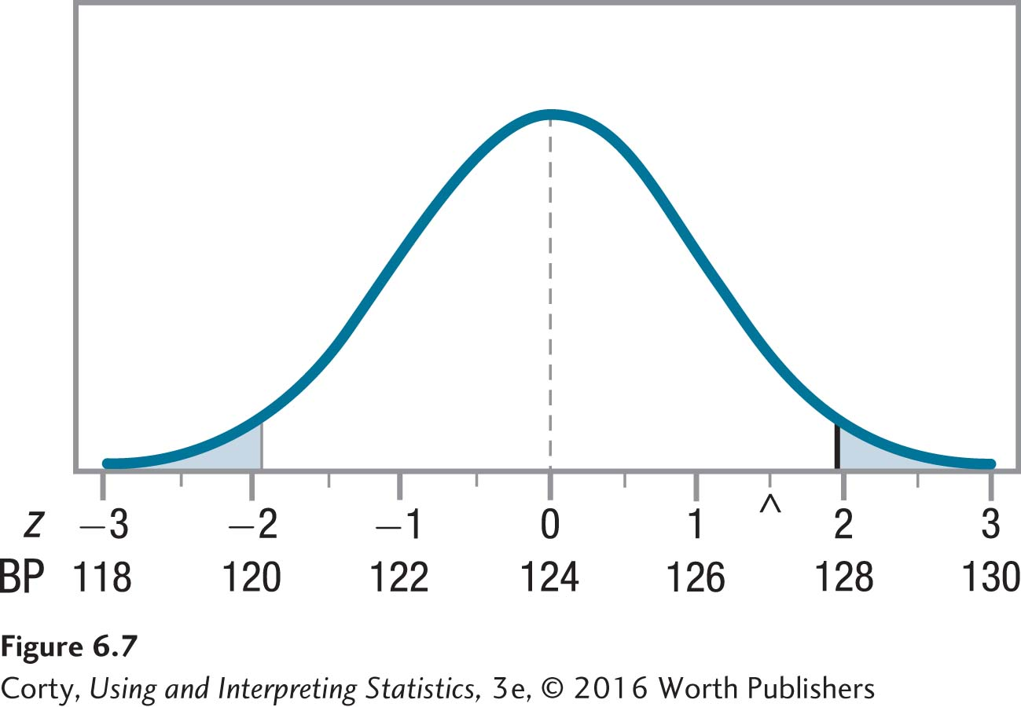
Type II Error and Beta: Example
Example: Blood Pressure
Dr. Levine studied a sample of 81 people whom a psychic believed had abnormal blood pressure
μ = 124, M = 127, σ = 18
H₀: μ = 124 H₁: μ ≠ 124
Two-tailed, single-sample z test, α= .05, critical value z = ± 1.96
Sampling Distribution of the Mean for Blood Pressure if μ = 124

Slide 31
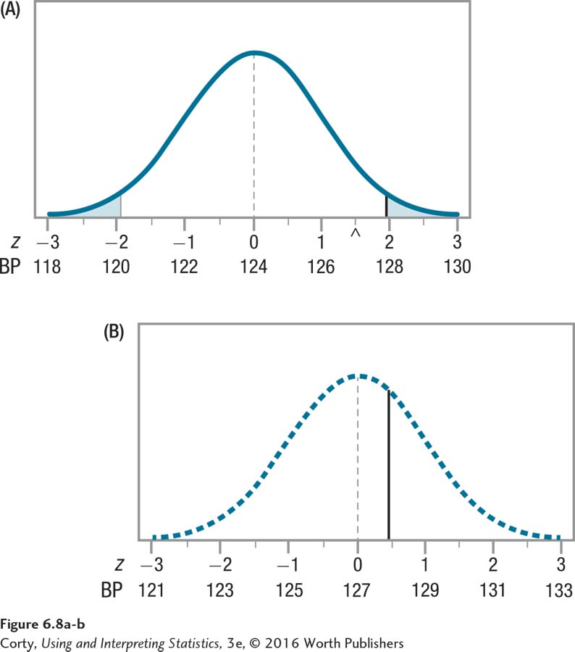
Type II Error and Beta: Example (continued)
Example: Blood Pressure
Imagine the null hypothesis is not true, μ = 127 instead of 124
Top panel (A), centered at 124, is the same as the sampling distribution in Figure 6.8.
Bottom panel (B) is centered at a blood pressure reading of 127 and shows what the sampling distribution would look like if that were the population mean.
Vertical line in the bottom panel is an extension of the critical value, z = 1.96, from the top panel.
Sampling Distribution if μ = 127

Slide 32
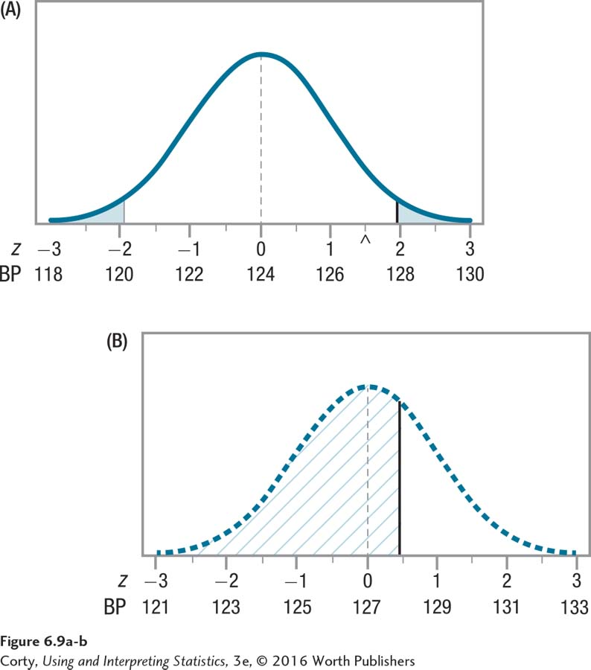
Type II Error and Beta: Example (continued)
Example: Blood Pressure
Area to the left of the solid vertical line in (B) has been hatched in.
Any sample mean that falls in the hatched area of the bottom panel would fall in the common zone of the top panel; H₀ would not be rejected.
But bottom distribution has a μ = 127, not 124; H₀ of μ = 124 should be rejected.
More than half of the distribution is shaded in; large probability of Type II error if we hypothesize μ = 124 but the population mean is really 127.
Probability of Type II Error (Beta) if μ = 127

Slide 33
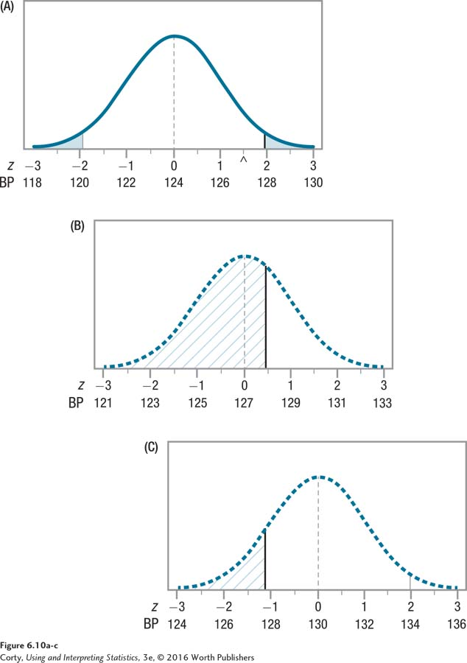
Impact of Effect Size on the Probability of Type II Error
Top panel (A) shows the sampling distribution if μ = 124.
Middle panel (B) if μ = 127.
Bottom panel (C) if μ = 130.
Shaded portion in panel (B) reflects beta, probability of Type II error if it is hypothesized that the population mean is 124 but it really is 127.
Shaded portion in the bottom distribution, which represents beta if μ = 130, is smaller.
When the effect is bigger, the probability of Type II error decreases.
Impact of Effect Size on the Probability of Type II Error

Slide 34
How to Choose: Type I vs. Type II Error
 | Type I Error | Type II Error
Definition | One rejects the null hypothesis when one should have failed to reject the null hypothesis. | One fails to reject the null hypothesis when the null hypothesis should have been rejected.
Erroneous conclusion reached | Reject the null hypothesis. | Fail to reject the null hypothesis.
Example of erroneous conclusion | Conclude that a treatment makes a difference in the outcome, but it really doesn’t. | Conclude there’s no evidence a treatment makes a difference in outcome, but it really does.
Probability of this error
Need to worry about making this error | If the null hypothesis is rejected. | If one fails to reject the null hypothesis

Slide 35
Power
Power
Refers to the probability of rejecting the null hypothesis when the null hypothesis should be rejected.
Why does the researcher want power to be high?
Because the goal of most studies is to reject the null hypothesis and be forced to accept the alternative hypothesis (which is what the researcher really believes is true), the researcher wants power to be as high as possible.

Slide 36
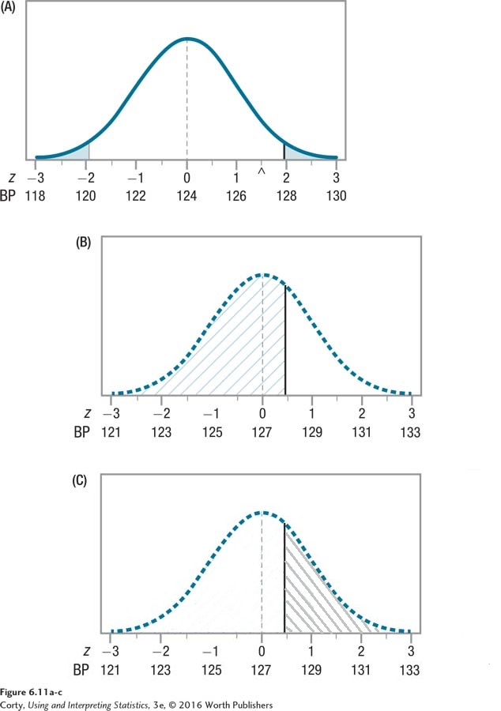
Power
Shaded area on top panel (A) is the rare zone; if a result falls there null hypothesis will be rejected.
Area hatched /// on middle panel (B) represents beta, probability of Type II error.
Area shaded \\\ on bottom panel (C) represents power, likelihood if μ = 127, that the null hypothesis, which claims it is 124, will be rejected.
Areas shaded /// and \\\ incorporate the whole distribution; probability of beta plus probability of power equals 1.
Relationship Between Beta and Power

Slide 37
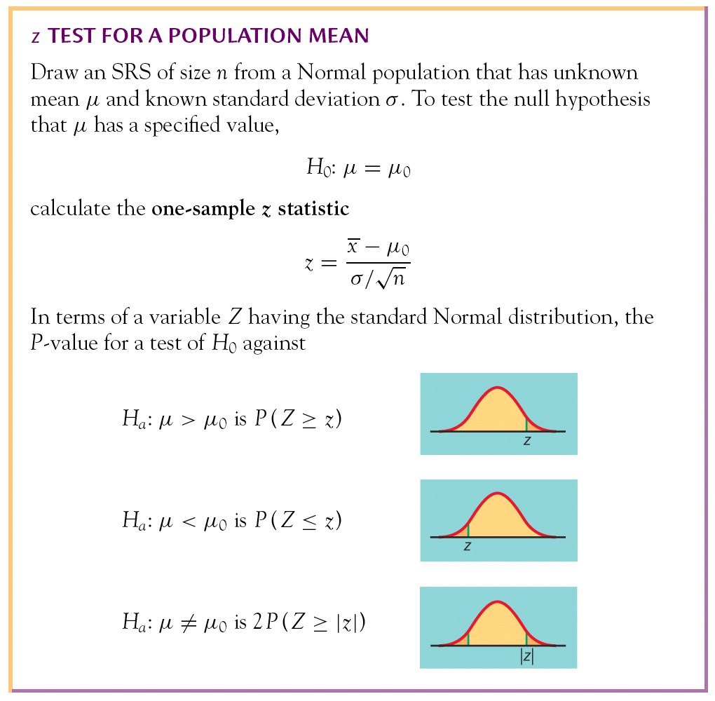
Significance Tests for a Population Mean

Slide 38


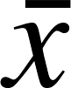
Example
The national Center for Health Statistics (NCHS) published a report in 2018 entitled “Health, United States,” and it contains extensive information on major treads in the health of Americans. The NSCH reported that the mean total cholesterol level in 2016 for all adults were 191.
In 2016, a total of n = 1870 participants attended in the Framingham Heart Study, a long-term, ongoing cardiovascular cohort study of residents of the city of Framingham, Massachusetts. Descriptive statistics showed on total cholesterol levels in these participants are = 192.1.
Suppose the total cholesterol levels follow a Normal distribution with standard deviation σ = 39.6.
Question: Is there a statistical evidence of a difference in mean cholesterol levels in the Framingham participants as compared to the national mean?

Slide 39
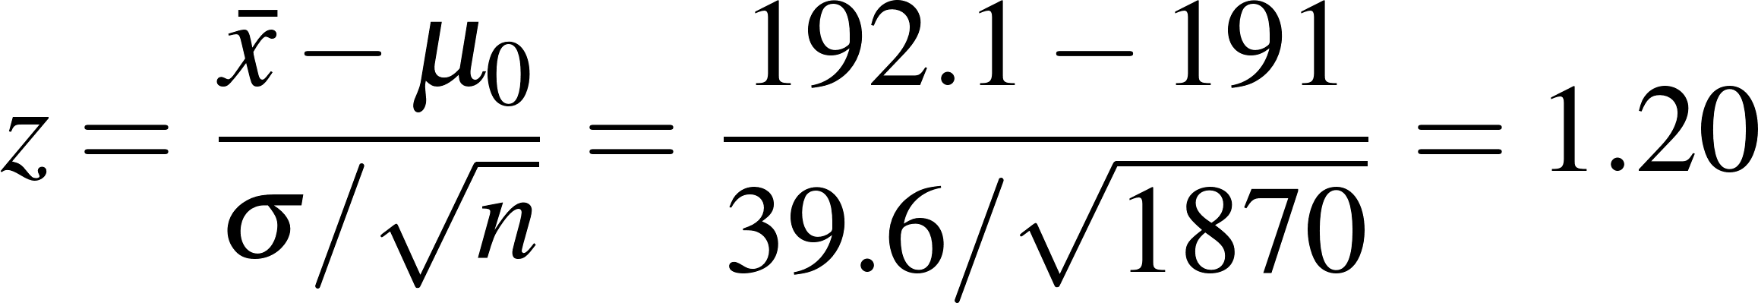
Example
Step 1: State the null and alternative hypotheses.
The parameter of interest is the mean total cholesterol level µ in the population.
Because the research question asked whether the sample mean of 192.1 in the Framingham sample is statistically significantly different from population mean of 191, the alternative hypothesis is two-sided; that is, either µ < 191 or µ > 191. For simplicity, we write this as µ ≠ 191. That is:
H₀: µ = 191
H_{a}: µ ≠ 191
Step 2: Calculate the value of the test statistic.

Slide 40
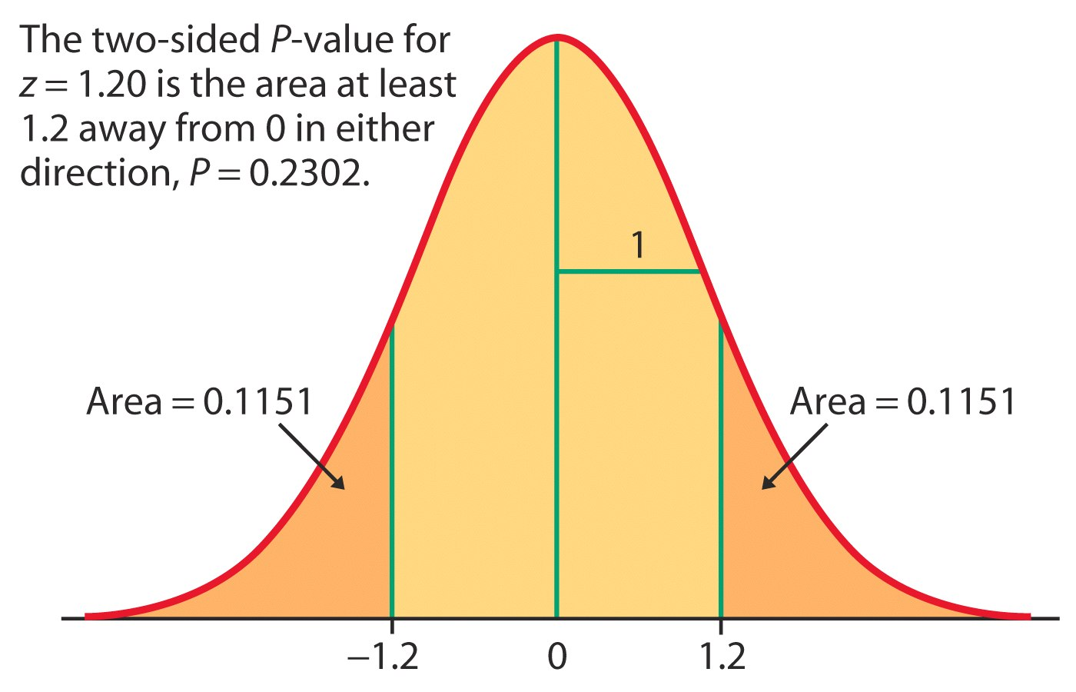
Example
Step 3: Find the P-value for the observed data.
For the test statistic z = 1.20 and alternative hypothesis H_{a}: μ ≠ 191, the P-value would be:
P-value = P(Z < –1.20 or Z > 1.20)
= 2 P(Z < –1.20) = 2 P(Z > 1.20) = (2)(0.1151) = 0.2302
Step 4: State a conclusion.
If H₀ is true, there is a chance of 0.2302 (23.02%) that we would see results at least as extreme as those in the sample. A probability of 0.2302 is not particularly small, and so the observed results are not unlikely if H₀ is true. This means there is not strong evidence in favor of H_{a}.
i.e., mean cholesterol levels in the Framingham participants IS NOT statistically significantly different from the national mean.

